Slide 1

Smart Shoe For Blind People
SDM Institute of Technology, Ujire Department of Information Science and Engineering
First Review of Project Phase-1
A Presentation on
Presented By
P J Prajanya Jain 4SU20IS028
Pooja 4SU20IS029
Prathvin P Shetty 4SU20IS031
Praveen M R 4SU20IS032
Under the Guidance of
Mrs.Shobha
Assistant Professor

Slide 2
Agenda
Introduction
Literature Survey
Problem Statement
System Requirements
Objectives
Methodology
Outcomes
References

Slide 3
Introduction
IOT is all about making physical stuffs communicating with each other and, hence our project is based on this application.
Smart shoes for blind person. This shoe will be enriched with various sensors with their numerous features which would help blind persons to make their way to destination. People with visually impaired faced most of the challenges in the environment.
Fire hydrants, potholes, steps, etc. are some of the obstacles people who are blind and low vision need to be careful about.

Slide 4
LITERATURE SURVEY
In this paper titled “Smart Assistive Shoes for Blind”,the authors are N. Sohan, H. S. Sai Rishab et al.They have stated that their project consists of assistive system which helps the blind to find obstacle free path based on the voice commands. The main aim of this research work is to provide a better solution regarding navigation system for blind people with all the mentioned functions.
In this paper titled “Internet of Things - Enabled Smart Shoes for Blind People”,the authors are Pratik Bhongade,Abdul Moeid Sheikh et al.They have stated that this Smart Shoe will be equipped with various sensors and the entire system is powered by two sources: two batteries as a primary source and piezoelectric plates as an alternate source that generates power when a blind person walks.

Slide 5
LITERATURE SURVEY
In this paper titled “Smart Shoes for Visually Impaired Using IOT” the authors are Manali Tayade,Harsh Kadam et al.This paper states that this shoe includes sensors to detect obstacles such as sidewalks, staircases, etc. Entire data received from the wearable sensors is displayed on the android device and the end-user can view and access .
In this paper titled “Smart Footwear for the Visually-Impaired People Based on Arduino Platform and Ultrasonic Sensors”,the authors are Valentina Balas, Muhammad Arif et al. This paper presents use of location system for suggesting the visually-impaired persons about the closest locations such as supermarkets, hospitals, institutions, etc.

Slide 6
LITERATURE SURVEY
In this paper titled “Design and Implementation of Smart Shoes for Blind and Visually Impaired People for More Secure Movements” and the authors are Jeffrey Chehade, Ali Hayek et al and this paper states that this system is developed to detect obstacles, wet floor and patients' falls In case of presence of one of the above incidents, the user will be notified acoustically using some voice alarms.

Slide 7
Problem Statement
Smart Shoe For Blind People
Blind and visually impaired people face a number of challenges in their daily lives, including navigating their surroundings safely and independently. Smart shoes have the potential to address these challenges by providing blind and visually impaired people with real-time information about their surroundings and helping them to avoid obstacles.

Slide 8
Problem Statement
Smart Shoe For Blind People
Blind and visually impaired people face a number of challenges in their daily lives, including navigating their surroundings safely and independently. Smart shoes have the potential to address these challenges by providing blind and visually impaired people with real-time information about their surroundings and helping them to avoid obstacles.

Slide 9
System Requirements
Hardware Requirements:
Aurdino nano
Ultrasonic Sensor
Battery 7.4 v
Buzzer
Vibrating Motor

Slide 10
Objectives
The objectives of the proposed work are :
To help the blind people to find obstacle free path.
To help the blind to reach the destination independently.
To increase the independence and mobility of the blind people.
To reduce the accidents and injuries of the blind people.

Slide 11
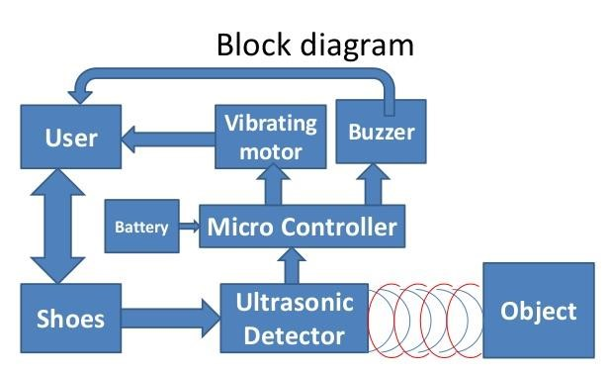
Methodology

Slide 12
We have interfaced microcontroller with ultrasonic sensor to detect the obstacles using ultrasonic waves.
The buzzer (sounds) alerts visually impaired people over objects which are coming between their ways and could help them in walking with less accident.
And, we used piezoelectric sensors (foot step power generation) it converts mechanical energy into electrical energy and it will be used as backup for battery.

Slide 13
Outcomes
The expected outcomes of the proposed work are :
The smart shoe project has the potential to make a significant positive impact on the lives of blind people.
Most promising outcomes of the smart shoe for blind people project is the potential to improve the mobility and independence of blind people.
Smart shoes could help blind people to participate more fully in all aspects of life and to participate in the things they enjoy.

Slide 14
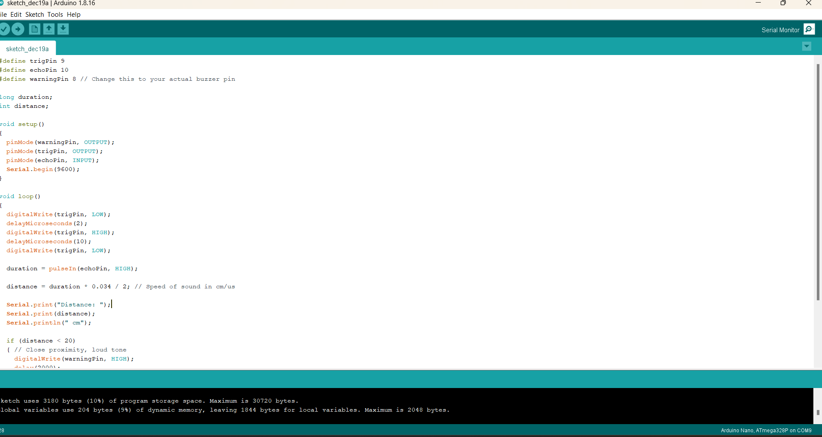
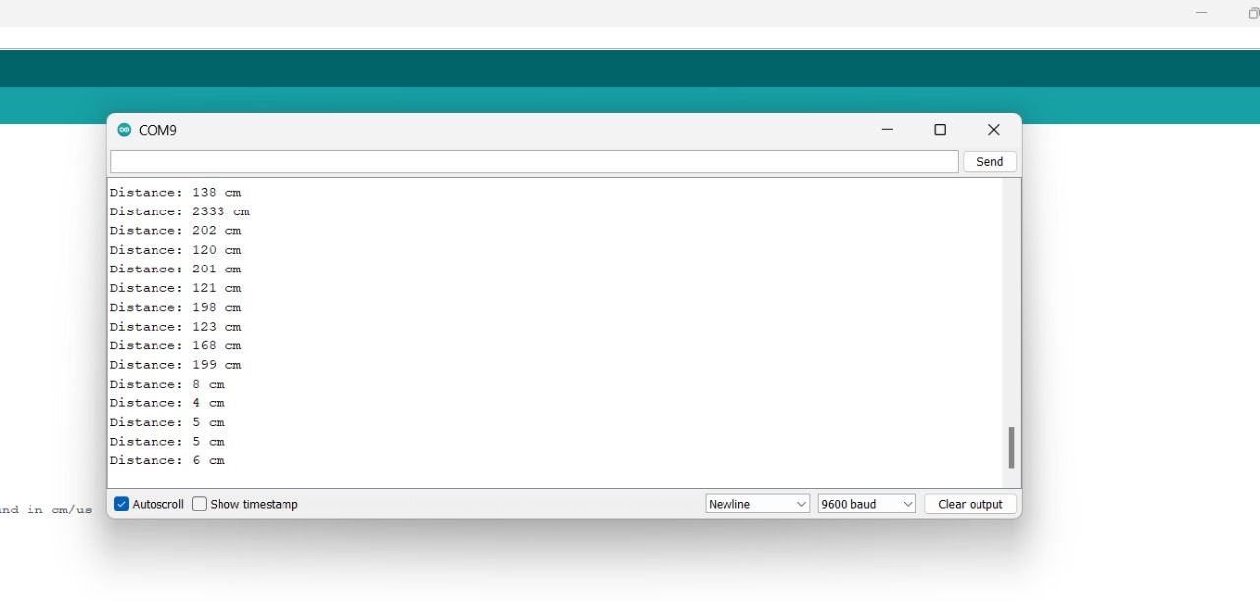




WORK DONE PHASE 1
The Previous work was completed by connecting Arduino Nano to the ultrasonic Sensor and buzzer where the ultrasonic sensor is used to detect the obstacle and buzzer is used to make an alert sound when the obstacle is detected.
Software:

Slide 15
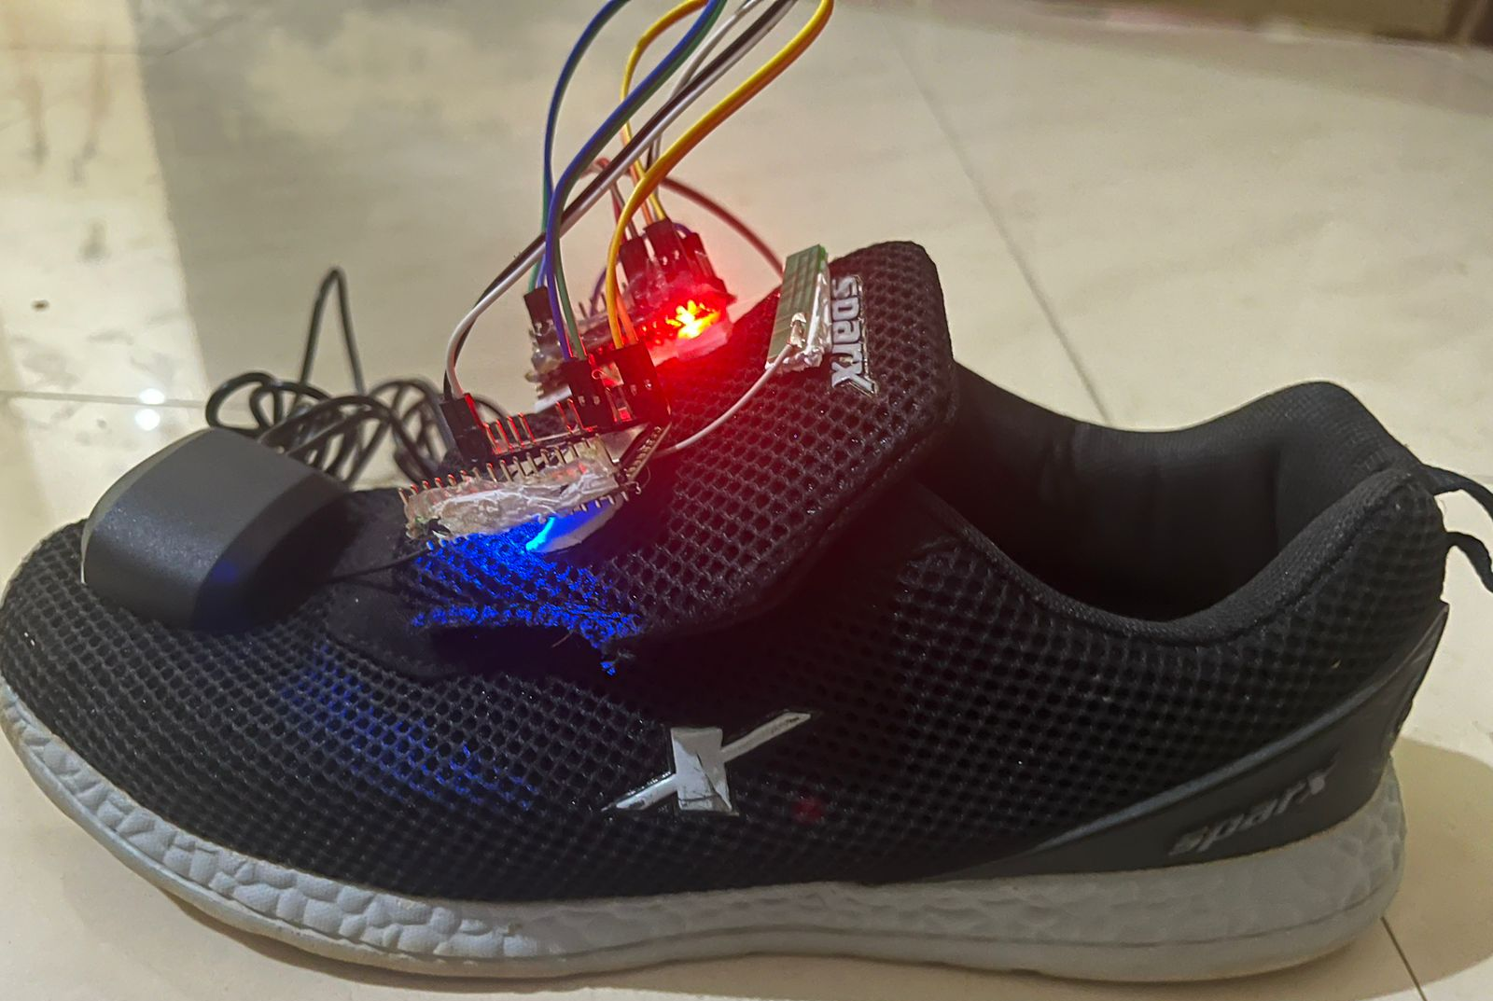
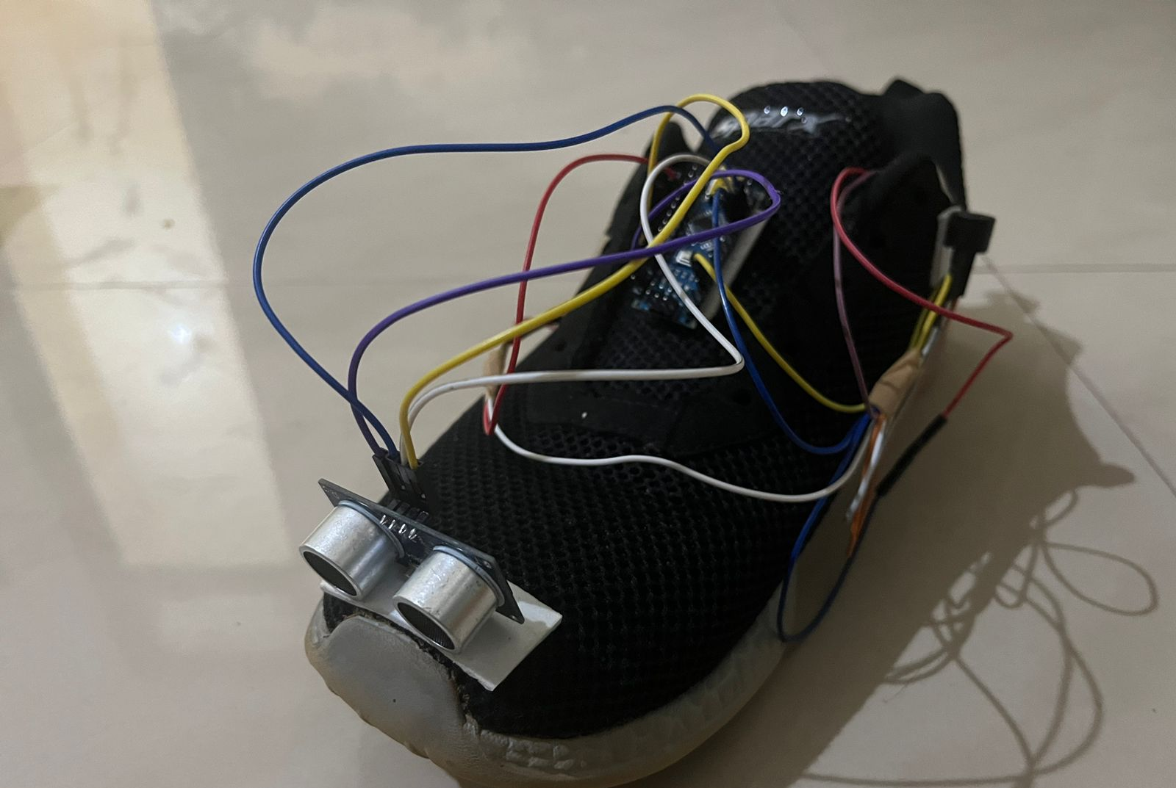
RESULTS

Slide 16
References
References of conference/journal paper or books or website in the specified below
Pradeep Kumar M, Inchara K M, Lekhashree S, Likhith C N, Real Time Assistive Shoe for Visually Impaired People, International Conference for Convergence for Technology.
Roy Abi Zeid Daou, Jeffrey Chehade, Georgio Abou Haydar, Ali Hayek ,Design and Implementation of Smart Shoes for Blind and Visually Impaired People for More Secure Movements ,International Conference on Microelectronics.
Teja Chava, A. Tarak Srinivas, A. Lohith Sai, Venubabu Rachapudi ,K L University ,IOT based smart shoe for blind, International Conference on Inventive Computation Technologies.

Slide 17
I.Suneetha, Angeri Sandhya, L.Rama Krishna reddy, H.Reddy Jyothika, C.Tharun,Smart Shoe for the Visually Impaired Using IOT ,International Journal of Advances in Engineering and Management (IJAEM),Volume 5.
Shelena Soosay Nathan, Kuan Jung Ying1, Lim Hui Wen, Lim Xin Weoi ,Design of Smart Walking Shoe for Visually Impaired People, Journal of Advanced Research in Applied Mechanics 101, Issue 1 (2023) 53-61.

Slide 18
14. ‘Thank You’ Slide (1 slide)
Just mention ‘THANK YOU’ on this slide.
Include ‘QUESTIONS?’ If you want.
THANK YOU

